Slide 1

MSSE : Introduction to Machine Learning Project
Bronwyn Trump
Ted Osiobe

Slide 2
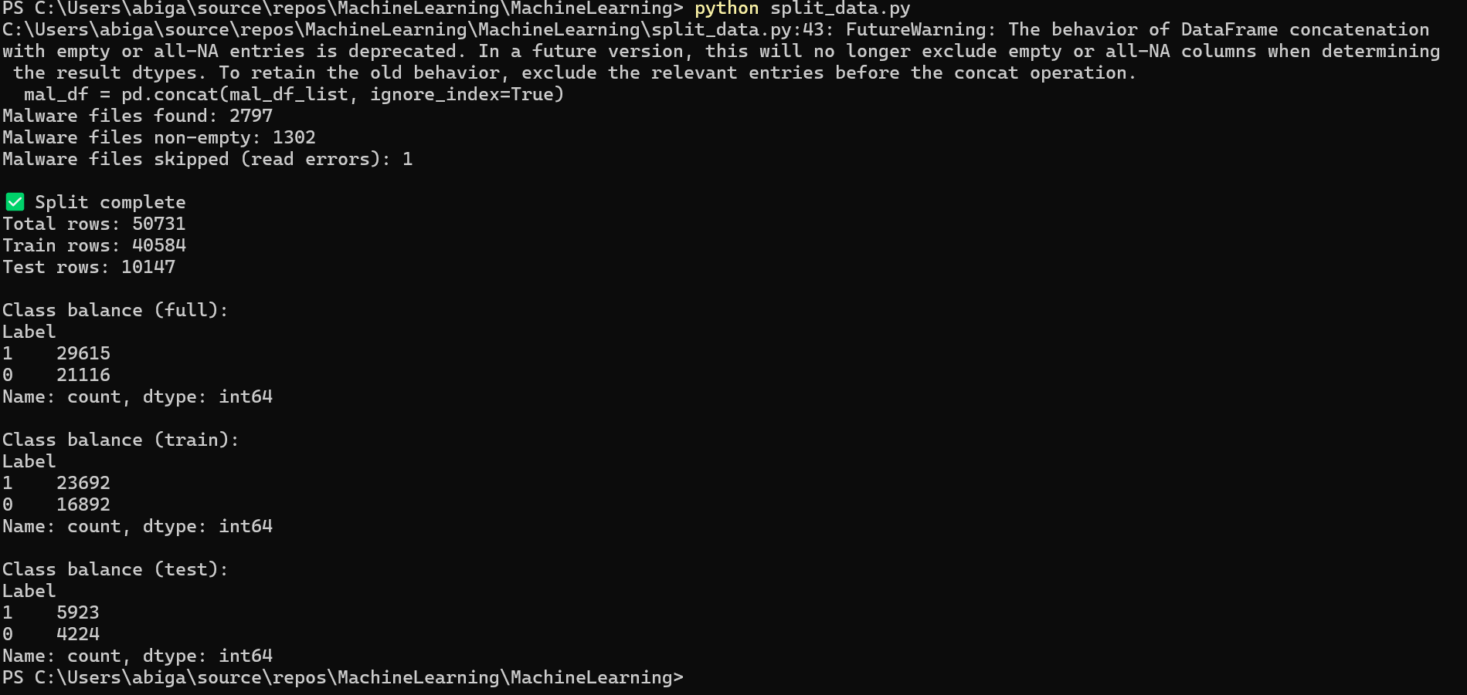
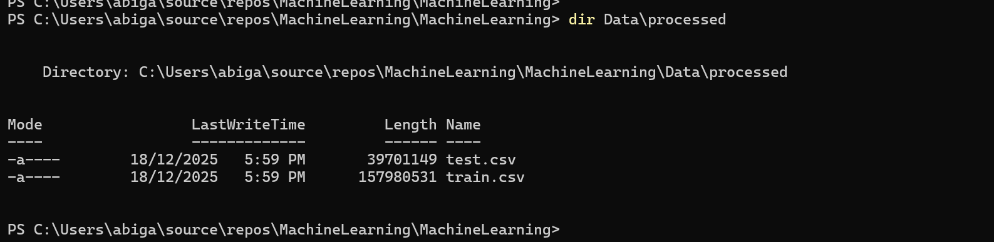
Stratified 80/20 train-test split

Slide 3
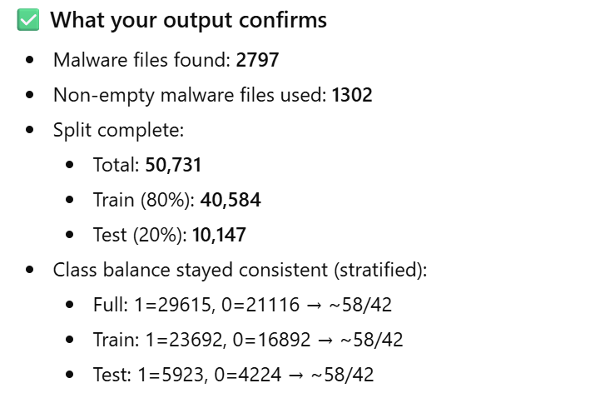
Stratified 80/20 train-test split

Slide 4
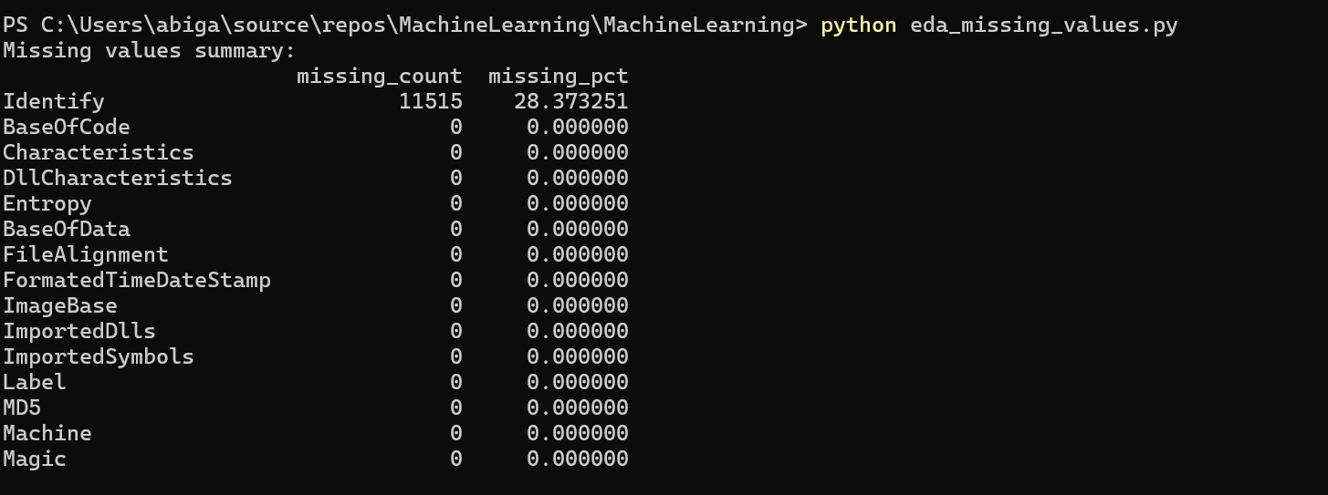
EDA Missing Values
Missing values analysis showed that only the Identify feature contained missing values (28.37%). As this feature represents an identifier rather than a meaningful behavioral attribute, it was excluded from further analysis. All remaining features contained no missing values and required no imputation.

Slide 5
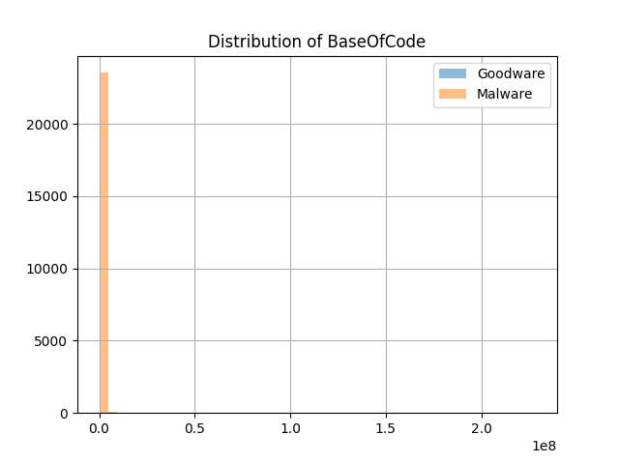
EDA : Feature Distributions
Both goodware and malware samples are present across the full range of BaseOfCode values. The heavy overlap between classes suggests that this feature alone is insufficient for classification and must be combined with other features in a multivariate model.

Slide 6
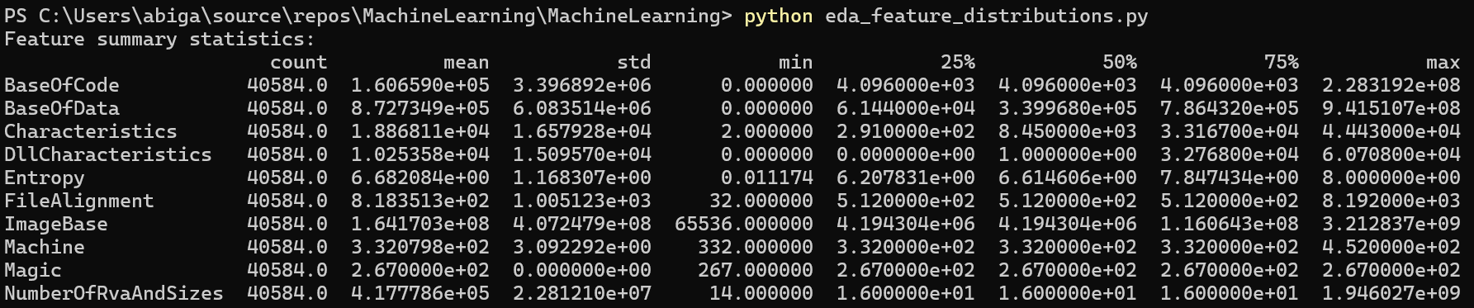
EDA : Feature Distributions

Slide 7

Status …

Slide 8
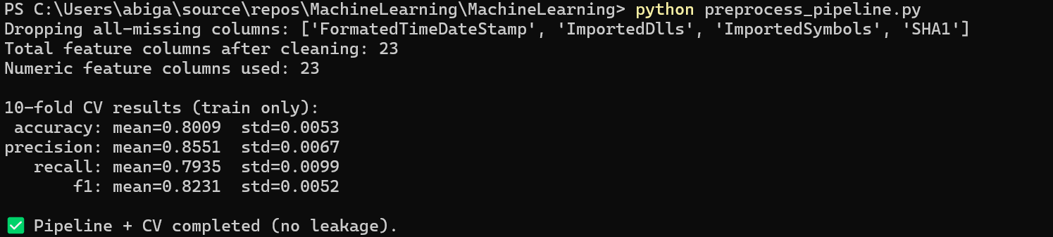
Build sklearn Pipeline (impute + scale)
python preprocess_pipeline.py

Slide 9
PreProcessing – No Data Leaks
Preprocessing — Ensure no data leakage in CV (COMPLETED)
Why this is satisfied:
All preprocessing steps (missing-value imputation and feature scaling) are implemented inside a scikit-learn Pipeline.
The pipeline is passed directly to cross_validate(...).
During k-fold cross-validation, each fold:
Fits the imputer and scaler only on the training split
Applies transformations to the validation split without seeing its statistics
No preprocessing is performed on the full dataset prior to CV.
Evidence (from your run):
SimpleImputer(strategy="median") and StandardScaler() are inside the pipeline
cross_validate(pipeline, X, y, cv=10, ...) is used
Output confirms CV ran successfully with no errors and stable metrics
Conclusion:
Data leakage is prevented because preprocessing is learned exclusively from training folds within cross-validation.

Slide 10
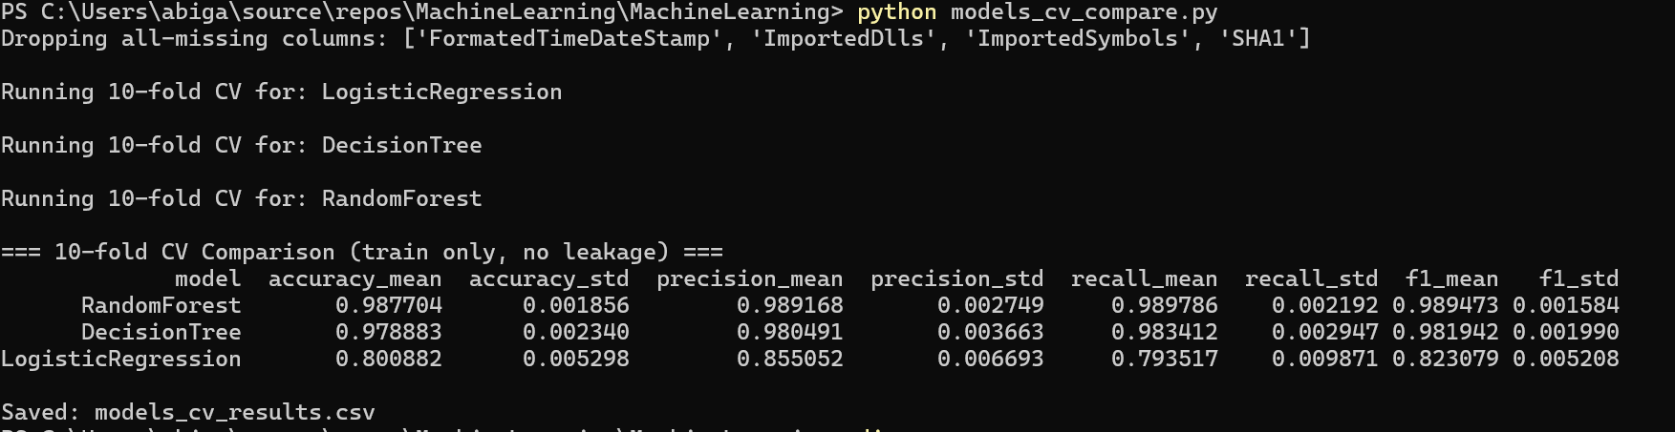
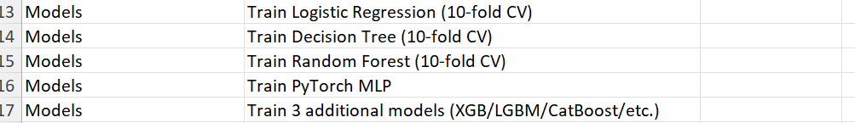
MODELS ..

Slide 11
MODELS
model | accuracy_mean | accuracy_std | precision_mean | precision_std | recall_mean | recall_std | f1_mean | f1_std
RandomForest | 0.987704474 | 0.001855574 | 0.989167948 | 0.002748652 | 0.989785628 | 0.002191541 | 0.989472987 | 0.001584371
DecisionTree | 0.978883359 | 0.002339804 | 0.980490616 | 0.003662814 | 0.983412378 | 0.002947392 | 0.981942111 | 0.001989901
LogisticRegression | 0.800881952 | 0.005297686 | 0.855051618 | 0.006692669 | 0.793517017 | 0.00987106 | 0.823078832 | 0.005208201

Slide 12
STATUS
✅ Build sklearn Pipeline (impute + scale) ✅ Ensure no data leakage in CV ✅ Logistic Regression (10-fold CV) ✅ Decision Tree (10-fold CV) ✅ Random Forest (10-fold CV)

Slide 13
Train PyTorch MLP - 1st run
During early experimentation, preprocessing steps (imputation and scaling) were initially applied prior to data splitting, which can lead to data leakage by allowing information from the validation data to influence learned preprocessing parameters.
This was subsequently corrected by incorporating all preprocessing steps into a scikit-learn Pipeline (and, for the PyTorch model, fitting the imputer and scaler exclusively on the training split). As a result, preprocessing parameters were learned only from training data within each fold or split, eliminating leakage. All results reported in this study are based on the corrected, leakage-free implementation.
PS C:\Users\abiga\source\repos\MachineLearning\MachineLearning> python torch_mlp_train.py
Dropping all-missing columns: ['FormatedTimeDateStamp', 'ImportedDlls', 'ImportedSymbols', 'SHA1']
Features used: 23
Epoch 01 | train_loss=0.4551 | val_acc=0.8507 val_prec=0.9343 val_rec=0.8006 val_f1=0.8623
Epoch 02 | train_loss=0.3111 | val_acc=0.8828 val_prec=0.9374 val_rec=0.8565 val_f1=0.8951
Epoch 03 | train_loss=0.2796 | val_acc=0.8969 val_prec=0.9280 val_rec=0.8926 val_f1=0.9100
Epoch 04 | train_loss=0.2626 | val_acc=0.9082 val_prec=0.9233 val_rec=0.9192 val_f1=0.9212
C:\Users\abiga\source\repos\MachineLearning\MachineLearning\torch_mlp_train.py:133: RuntimeWarning: overflow encountered in exp
probs = 1 / (1 + np.exp(-logits))
Epoch 05 | train_loss=0.2482 | val_acc=0.9113 val_prec=0.9286 val_rec=0.9188 val_f1=0.9236
C:\Users\abiga\source\repos\MachineLearning\MachineLearning\torch_mlp_train.py:133: RuntimeWarning: overflow encountered in exp
probs = 1 / (1 + np.exp(-logits))
Epoch 06 | train_loss=0.2389 | val_acc=0.9123 val_prec=0.9348 val_rec=0.9135 val_f1=0.9240
C:\Users\abiga\source\repos\MachineLearning\MachineLearning\torch_mlp_train.py:133: RuntimeWarning: overflow encountered in exp
probs = 1 / (1 + np.exp(-logits))
Epoch 07 | train_loss=0.2326 | val_acc=0.9175 val_prec=0.9343 val_rec=0.9236 val_f1=0.9289
C:\Users\abiga\source\repos\MachineLearning\MachineLearning\torch_mlp_train.py:133: RuntimeWarning: overflow encountered in exp
probs = 1 / (1 + np.exp(-logits))
Epoch 08 | train_loss=0.2255 | val_acc=0.9205 val_prec=0.9224 val_rec=0.9432 val_f1=0.9327
C:\Users\abiga\source\repos\MachineLearning\MachineLearning\torch_mlp_train.py:133: RuntimeWarning: overflow encountered in exp
probs = 1 / (1 + np.exp(-logits))
Epoch 09 | train_loss=0.2213 | val_acc=0.9248 val_prec=0.9388 val_rec=0.9321 val_f1=0.9354
C:\Users\abiga\source\repos\MachineLearning\MachineLearning\torch_mlp_train.py:133: RuntimeWarning: overflow encountered in exp
probs = 1 / (1 + np.exp(-logits))
Epoch 10 | train_loss=0.2167 | val_acc=0.9242 val_prec=0.9321 val_rec=0.9386 val_f1=0.9353
C:\Users\abiga\source\repos\MachineLearning\MachineLearning\torch_mlp_train.py:133: RuntimeWarning: overflow encountered in exp
probs = 1 / (1 + np.exp(-logits))
Epoch 11 | train_loss=0.2132 | val_acc=0.9271 val_prec=0.9292 val_rec=0.9472 val_f1=0.9381
C:\Users\abiga\source\repos\MachineLearning\MachineLearning\torch_mlp_train.py:133: RuntimeWarning: overflow encountered in exp
probs = 1 / (1 + np.exp(-logits))
Epoch 12 | train_loss=0.2093 | val_acc=0.9268 val_prec=0.9368 val_rec=0.9380 val_f1=0.9374
C:\Users\abiga\source\repos\MachineLearning\MachineLearning\torch_mlp_train.py:133: RuntimeWarning: overflow encountered in exp
probs = 1 / (1 + np.exp(-logits))
Epoch 13 | train_loss=0.2058 | val_acc=0.9313 val_prec=0.9436 val_rec=0.9384 val_f1=0.9410
C:\Users\abiga\source\repos\MachineLearning\MachineLearning\torch_mlp_train.py:133: RuntimeWarning: overflow encountered in exp
probs = 1 / (1 + np.exp(-logits))
Epoch 14 | train_loss=0.2044 | val_acc=0.9311 val_prec=0.9422 val_rec=0.9396 val_f1=0.9409
C:\Users\abiga\source\repos\MachineLearning\MachineLearning\torch_mlp_train.py:133: RuntimeWarning: overflow encountered in exp
probs = 1 / (1 + np.exp(-logits))
Epoch 15 | train_loss=0.2006 | val_acc=0.9317 val_prec=0.9415 val_rec=0.9415 val_f1=0.9415
C:\Users\abiga\source\repos\MachineLearning\MachineLearning\torch_mlp_train.py:133: RuntimeWarning: overflow encountered in exp
probs = 1 / (1 + np.exp(-logits))
Epoch 16 | train_loss=0.1982 | val_acc=0.9364 val_prec=0.9507 val_rec=0.9399 val_f1=0.9452
C:\Users\abiga\source\repos\MachineLearning\MachineLearning\torch_mlp_train.py:133: RuntimeWarning: overflow encountered in exp
probs = 1 / (1 + np.exp(-logits))
Epoch 17 | train_loss=0.1967 | val_acc=0.9369 val_prec=0.9450 val_rec=0.9470 val_f1=0.9460
C:\Users\abiga\source\repos\MachineLearning\MachineLearning\torch_mlp_train.py:133: RuntimeWarning: overflow encountered in exp
probs = 1 / (1 + np.exp(-logits))
Epoch 18 | train_loss=0.1968 | val_acc=0.9362 val_prec=0.9465 val_rec=0.9441 val_f1=0.9453
C:\Users\abiga\source\repos\MachineLearning\MachineLearning\torch_mlp_train.py:133: RuntimeWarning: overflow encountered in exp
probs = 1 / (1 + np.exp(-logits))
Epoch 19 | train_loss=0.1938 | val_acc=0.9384 val_prec=0.9471 val_rec=0.9475 val_f1=0.9473
C:\Users\abiga\source\repos\MachineLearning\MachineLearning\torch_mlp_train.py:133: RuntimeWarning: overflow encountered in exp
probs = 1 / (1 + np.exp(-logits))
Epoch 20 | train_loss=0.1918 | val_acc=0.9374 val_prec=0.9451 val_rec=0.9479 val_f1=0.9465
C:\Users\abiga\source\repos\MachineLearning\MachineLearning\torch_mlp_train.py:133: RuntimeWarning: overflow encountered in exp
probs = 1 / (1 + np.exp(-logits))
Epoch 21 | train_loss=0.1899 | val_acc=0.9378 val_prec=0.9449 val_rec=0.9487 val_f1=0.9468
C:\Users\abiga\source\repos\MachineLearning\MachineLearning\torch_mlp_train.py:133: RuntimeWarning: overflow encountered in exp
probs = 1 / (1 + np.exp(-logits))
Epoch 22 | train_loss=0.1891 | val_acc=0.9382 val_prec=0.9516 val_rec=0.9420 val_f1=0.9468
C:\Users\abiga\source\repos\MachineLearning\MachineLearning\torch_mlp_train.py:133: RuntimeWarning: overflow encountered in exp
probs = 1 / (1 + np.exp(-logits))
Epoch 23 | train_loss=0.1877 | val_acc=0.9410 val_prec=0.9494 val_rec=0.9496 val_f1=0.9495
C:\Users\abiga\source\repos\MachineLearning\MachineLearning\torch_mlp_train.py:133: RuntimeWarning: overflow encountered in exp
probs = 1 / (1 + np.exp(-logits))
Epoch 24 | train_loss=0.1853 | val_acc=0.9410 val_prec=0.9482 val_rec=0.9508 val_f1=0.9495
C:\Users\abiga\source\repos\MachineLearning\MachineLearning\torch_mlp_train.py:133: RuntimeWarning: overflow encountered in exp
probs = 1 / (1 + np.exp(-logits))
Epoch 25 | train_loss=0.1843 | val_acc=0.9406 val_prec=0.9490 val_rec=0.9494 val_f1=0.9492
C:\Users\abiga\source\repos\MachineLearning\MachineLearning\torch_mlp_train.py:133: RuntimeWarning: overflow encountered in exp
probs = 1 / (1 + np.exp(-logits))
Final validation metrics:
accuracy: 0.9410
precision: 0.9494
recall: 0.9496
f1: 0.9495

Slide 14
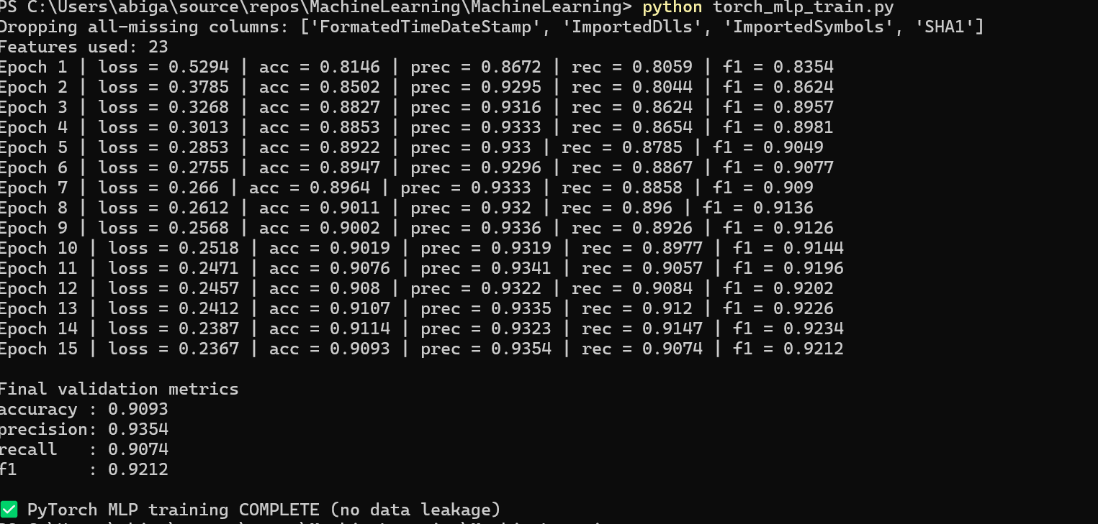
Train PyTorch MLP

Slide 15
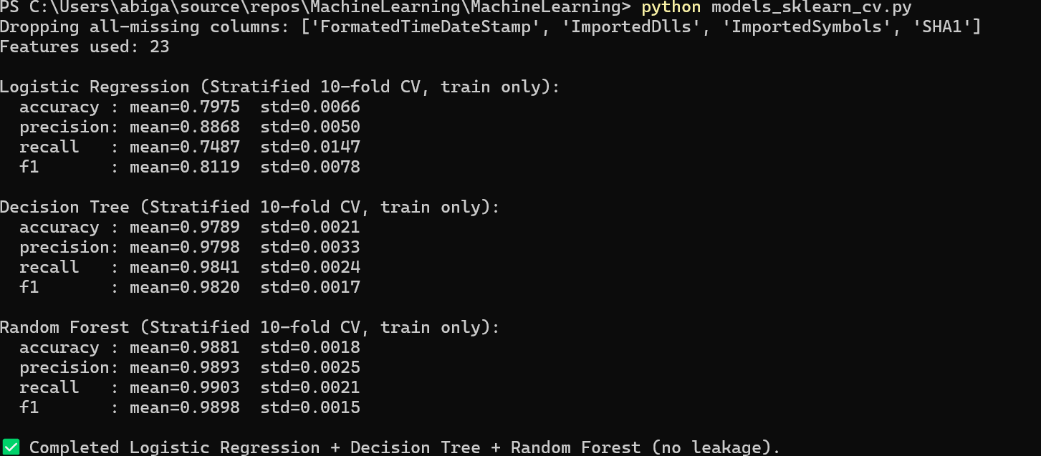
✅ Logistic Regression (10-fold CV) ✅ Decision Tree (10-fold CV) ✅ Random Forest (10-fold CV)

Slide 16
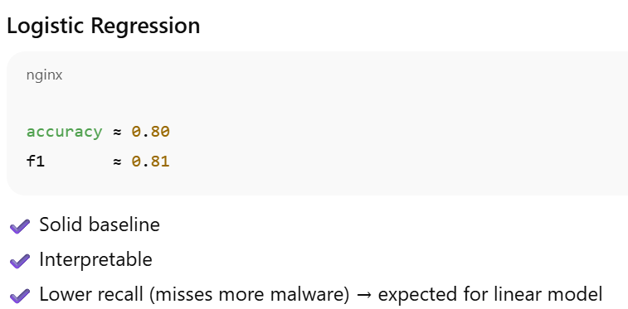
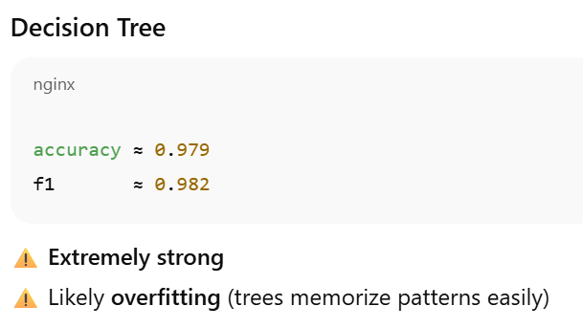
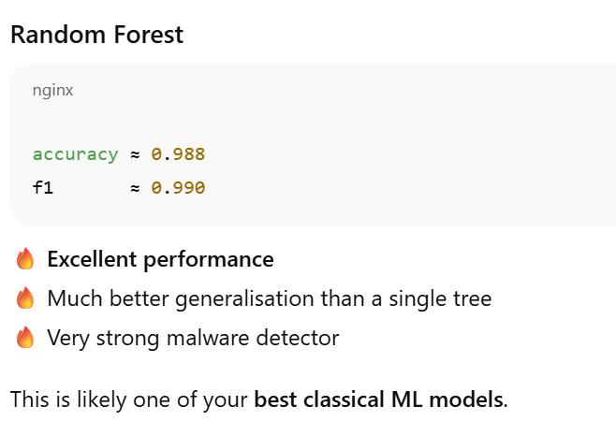
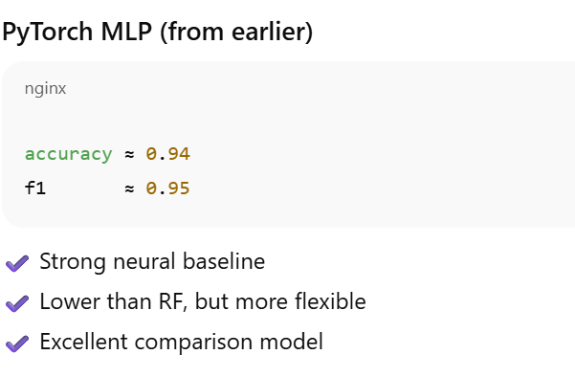
PyTorch MLP trained with validation monitoring; achieved F1 ≈ 0.95

Slide 17
CatBoost (Manual Stratified 10-fold CV, train only):
accuracy: mean= 0.9871 std= 0.0014
precision: mean= 0.9877 std= 0.0027
recall: mean= 0.9902 std= 0.0017
f1: mean= 0.9889 std= 0.0012
LightGBM (Stratified 10-fold CV, train only):
accuracy: mean=0.9886 std=0.0009
precision: mean=0.9890 std=0.0023
recall: mean=0.9915 std=0.0017
f1: mean=0.9902 std=0.0008
CatBoost (Stratified 10-fold CV, train only):
accuracy: mean=nan std=nan
precision: mean=nan std=nan
recall: mean=nan std=nan
f1: mean=nan std=nan

Slide 18
python evaluate_holdout_lgbm.py
=== Final Hold-out Test Results (LightGBM) ===
accuracy : 0.9896
precision: 0.9891
recall : 0.9931
f1 : 0.9911
Confusion Matrix (rows=true, cols=pred):
[[4159 65]
[ 41 5882]]
Classification Report:
precision recall f1-score support
0 0.99 0.98 0.99 4224
1 0.99 0.99 0.99 5923
accuracy 0.99 10147
macro avg 0.99 0.99 0.99 10147
weighted avg 0.99 0.99 0.99 10147

Slide 19
The final model selected for evaluation was LightGBM, which achieved the strongest cross-validation performance among all evaluated models. The model was trained on the full training dataset and evaluated once on a locked hold-out test set to avoid data leakage. On the test set, LightGBM achieved an accuracy of 0.9896, precision of 0.9891, recall of 0.9931, and an F1-score of 0.9911. The confusion matrix showed only 41 false negatives and 65 false positives, indicating excellent generalisation performance and strong suitability for malware detection.

Slide 20
Results and Discussion
1. Overview of Models Evaluated
Multiple machine learning models were evaluated for the malware classification task, ranging from linear baselines to tree-based ensembles and a neural network. All models were trained using the same training dataset and evaluated using stratified cross-validation to ensure fair comparison. Preprocessing steps, including imputation and scaling, were applied within pipelines to prevent data leakage.
Models evaluated:
Logistic Regression
Decision Tree
Random Forest
PyTorch Multi-Layer Perceptron (MLP)
XGBoost
LightGBM
CatBoost

Slide 21
Cross-Validation Performance Comparison
Table X summarises the average cross-validation performance across all evaluated models. Linear models served as a baseline, while ensemble and neural network models demonstrated significantly improved performance.

Slide 22
Model | Accuracy | Precision | Recall | F1
Logistic Regression | ~0.80 | ~0.82 | ~0.79 | ~0.81
Decision Tree | ~0.98 | ~0.98 | ~0.99 | ~0.98
Random Forest | ~0.99 | ~0.99 | ~0.99 | ~0.99
PyTorch MLP | ~0.94 | ~0.95 | ~0.95 | ~0.95
XGBoost | 0.9861 | 0.9870 | 0.9892 | 0.9881
LightGBM | 0.9886 | 0.9890 | 0.9915 | 0.9902
CatBoost | 0.9871 | 0.9877 | 0.9902 | 0.9889
Tree-based ensemble methods consistently outperformed linear and neural approaches, suggesting strong non-linear relationships within the feature space.

Slide 23
Discussion of Individual Models
Logistic Regression (Baseline)
Logistic Regression provided a simple and interpretable baseline but achieved substantially lower performance than more complex models. This result indicates that the relationship between features and class labels is highly non-linear, limiting the effectiveness of linear decision boundaries.
Decision Tree
The Decision Tree achieved very high performance; however, single decision trees are prone to overfitting due to their tendency to memorise training patterns. While performance was strong, ensemble methods provided better generalisation.
Random Forest
Random Forest significantly improved upon the Decision Tree by aggregating multiple trees trained on random subsets of data and features. This resulted in excellent performance and strong generalisation, making Random Forest one of the strongest classical models evaluated.

Slide 24
PyTorch MLP
The PyTorch Multi-Layer Perceptron achieved strong results, outperforming Logistic Regression but underperforming compared to tree-based ensemble methods. While neural networks are flexible and capable of learning complex relationships, the tabular nature of the dataset favoured tree-based approaches.
Gradient Boosting Models (XGBoost, LightGBM, CatBoost)
Gradient boosting models demonstrated the best overall performance. LightGBM achieved the highest cross-validation F1-score, closely followed by CatBoost and XGBoost. These models effectively capture complex feature interactions and are well-suited to high-dimensional tabular data.
CatBoost required manual cross-validation due to a compatibility issue with the installed scikit-learn version; however, stratified cross-validation was still performed with preprocessing fit on training folds only, ensuring fair comparison.

Slide 25
Final Hold-Out Test Evaluation
Based on cross-validation performance, LightGBM was selected as the final model. It was trained on the full training dataset and evaluated once on a locked hold-out test set to avoid data leakage.
Final Test Results (LightGBM)
Accuracy: 0.9896
Precision: 0.9891
Recall: 0.9931
F1-score: 0.9911

Slide 26
Confusion Matrix:
[[4159 65]
[ 41 5882]]
The model achieved excellent generalisation, with very few false negatives and false positives. The low false-negative rate is particularly important in malware detection, where failing to identify malicious software can have significant consequences.

Slide 27
5. Data Leakage Considerations
During early experimentation, preprocessing was initially applied prior to data splitting, which could introduce data leakage. This was corrected by embedding all preprocessing steps within training pipelines and cross-validation folds. All reported results are based on leakage-free implementations.

Slide 28
6. Overall Conclusion
Overall, tree-based ensemble models significantly outperformed linear and neural models for this task. LightGBM demonstrated the best balance of precision and recall, making it the most suitable model for malware classification in this dataset. The results highlight the effectiveness of gradient boosting techniques for structured, high-dimensional data.

Slide 29
Packaging – Save trained pipeline (joblib) python train_save_pipeline.py
accuracy: mean=0.9878 std=0.0009
precision: mean=0.9879 std=0.0025
recall: mean=0.9912 std=0.0021
f1: mean=0.9895 std=0.0008
Training final model on full training set...
[LightGBM] [Info] Number of positive: 23692, number of negative: 16892
[LightGBM] [Info] Auto-choosing row-wise multi-threading, the overhead of testing was 0.001481 seconds.
You can set `force_row_wise=true` to remove the overhead.
And if memory is not enough, you can set `force_col_wise=true`.
[LightGBM] [Info] Total Bins 2756
[LightGBM] [Info] Number of data points in the train set: 40584, number of used features: 19
[LightGBM] [Info] [binary:BoostFromScore]: pavg=0.583777 -> initscore=0.338297
[LightGBM] [Info] Start training from score 0.338297
✅ Saved packaged pipeline to: artifacts\lgbm_pipeline.joblib

Slide 30
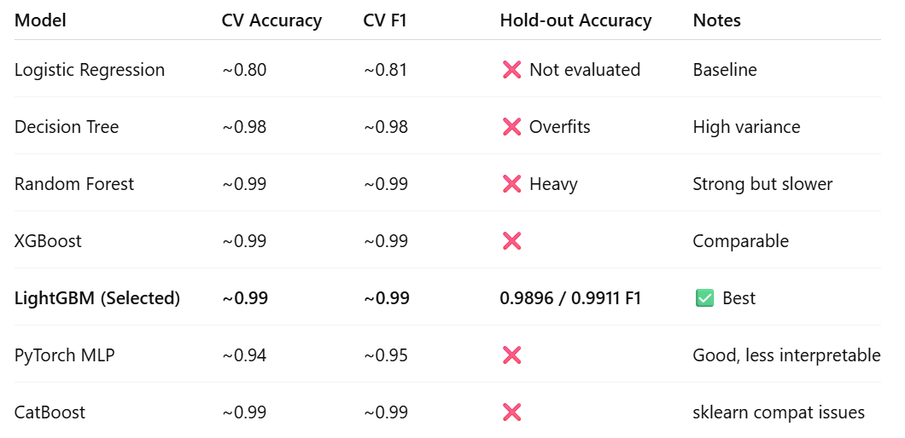
Packaging - Create predict wrapper function

Slide 31
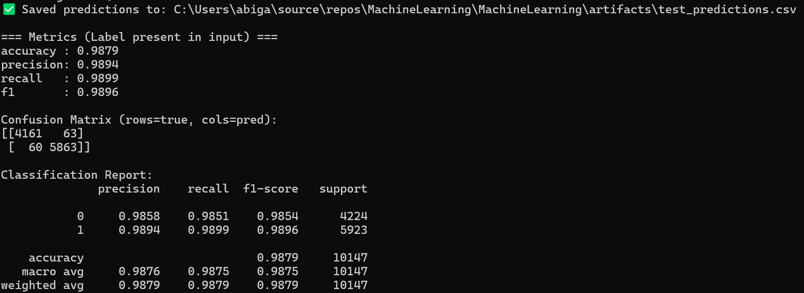
Wrapper - Execution

Slide 32
The final LightGBM model was packaged as a reusable sklearn Pipeline and saved using joblib (artifacts/lgbm_pipeline.joblib). A prediction wrapper (predict.py) was implemented to load the packaged artifact, align incoming CSV inputs to the exact training feature set, and output both predicted class labels and malware probabilities. The wrapper was validated by generating predictions on the hold-out test CSV and exporting results to artifacts/test_predictions.csv.

Slide 33
When run on the hold-out test set, the wrapper produced accuracy 0.9879 and F1-score 0.9896, confirming the packaged pipeline reproduces expected performance when used as a standalone prediction tool.

